Slide 1
Agency Prepayment: Refinance
May 2016

Slide 2
Model Update Overview 1. Data Set
1
Modeling Refinance – a three steps process
In order to get refinance from total prepayment, we need to subtract turnover, Defaults and Curtailments using model prediction results for each of the sub-modules.
Use a three steps process to get refinance model fitting:
Use pre 2007 none-media effect period to build baseline S-curve;
All pre 2007 data to fit Media Effect curve
All the data to fit Credit Availability and pool characteristic curves (WALA, burnout, loan size, CLTV etc.)
2
Pool Level Data Set
Consistent with other modules, we use pool level information to fit and track refinance module.
The following data are calculated using WA of loan level data:
incentive, burnout, refi-Eligibility%, HARPed%
3
Data Updates
Incentive: Incorporated incentive from conventional loan to FHA loan
Burnout: Included LLPA and PMI when calculate relative incentive
Refi-Eligible %: Based on LLPA and PMI underwriting guideline, marked the loans eligibility of refinance
Origination Channel: Using the distribution information of third party origination

Slide 3
Model Update Overview 2. Model Structure
Refinance model v1
Updates
3
1. Incorporate FHA in the incentive calculation
Steps Fitting
More closer to the reality, when borrowers consider to refi, they will have an option to refi into FHA program. We need to take that option into our incentive calculation.
Using three data sets to get fitting for difference curves
2. Update burnout with LLPA and PMI
When calculate the relative incentive, incorporate LLAP and PMI. And the calculation should be done on loan level (refer to the PL and LL dispersion in turnover presentation).
7
Parameters
3. Add refi eligibility flag
S Curve
Media Effect
Credit Availability
WALA
Burnout
Loan Size
CLTV
Based on LLPA and PMI underwriting guideline, marked the loans eligibility of refinance.
4. Add HARPed %
We added a new parameter to measure the potion of loans in each pool that come through HARP, as they will show a much lower refinance speed compare with others.
5. Add constraints for extrapolation
Using cap and floors for out of range extrapolation. Make sure the tail performance is reasonable.

Slide 4
Model Update Overview 2. Streamline Model Parameters
Refinance model v1
Refinance model v2
3
3
Steps Fitting
Steps Fitting
Using three data sets to get fitting for difference curves
Keep the 3 steps process in model v1. Get fitting for baseline s-curve, media effect, credit availability, and pool characterises curves sequentially.
7
10
Parameters
Parameters
S Curve
Media Effect
Credit Availability
WALA
Burnout
Loan Size
CLTV
S Curve
Media Effect
Credit Availability
WALA
Burnout
Loan size
CLTV
Refi-Elig %
HARPed %
TPO %
1
Constraint
Constraints for extrapolation

Slide 5
Model Update Overview 2. Model Structure
3
Pre 2007
None Media Effect
Data set
Base S Curve
Steps Fitting
Keep the 3 steps process in model v1. Get fitting for baseline s-curve, media effect, credit availability, and pool characterises curves sequentially.
Pre 2007
All
Data set
Media Effect
10
Parameters
All Data
Credit Availability
S Curve
Media Effect
Credit Availability
WALA
Burnout
Loan size
CLTV
Refi-Elig %
HARPed %
TPO %
Pool Characteristics:
WALA
Burnout
Loan size
CLTV
Refi-Elig %
HARPed %
TPO %
1
Constraint
Constraints for extrapolation

Slide 6
Data Preparation 1. Incentive – From Conventional to FHA
Q
uestion
Our current calculation for incentive only measures refinance incentive from conventional program to conventional. Do borrowers have other choices? If so, how we can capture that?
P
roblem
Other than refinance into conventional programs, current conventional borrowers do have other choices, like refi into FHA loans.
A rational borrower will choose the program that gives him largest incentive.
Currently, as FHA doesn’t have a risk based MIP, borrowers with poor profile(higher CLTV/lower FICO) has bigger incentive to refi into FHA loans.
S
olution
We calculate the incentive for each conventional loan that refi into conventional or FHA separately.
The max number of those two numbers will be the total incentive to refinance.

Slide 7
Data Preparation 1. Incentive – From Conventional to FHA
Incentive | = | Current Loan Cost | - | New Loan Cost
Incentive to Conv. | = | (OrigNoteRate + Current Paying PMI) | - | (PMMS + LLPA/4 + PMI)
Incentive to FHA | = |  | - | (FHA Mgt Rate + Upfront MIP/12 + Annual MIP)
Overall Incentive | = | Max ( Incentive to Conv., Incentive to FHA )
2
Major Differences
1. Mortgage Rate
2. Risk-based Costs
LTV - Lower | LTV - Upper | 760+ | 740-759 | 720-739 | 700-719 | 680-699 | 660-679 | 640-659 | 620-639
95.01 | 97 | 0.04 | 0.26 | 0.50 | 0.68 | 1.06 | 1.47 | 1.73 | 2.00
90.01 | 95 | -0.20 | 0.01 | 0.17 | 0.34 | 0.60 | 0.95 | 1.08 | 1.24
85.01 | 90 | -0.34 | -0.20 | -0.09 | 0.06 | 0.21 | 0.53 | 0.63 | 0.73
0.01 | 85 | -0.46 | -0.42 | -0.37 | -0.29 | -0.20 | -0.06 | 0.01 | 0.08
Conv-to-FHA Cost Difference

Slide 8
Data Preparation 1. Incentive – From Conventional to FHA
For FGLMC pools, we see that refi into GNMA incentive is lower than incentive to conventional
With CLTV growth up, GNMA incentive gradually get higher. For the CLTV group (90, 97), we see GNMA incentive took advantage beginning from 2013
For the U6 pools, GNMA incentives are much higher.
As FHA doesn’t have a risk based MIP, borrowers with poor profile(higher CLTV/lower FICO) has bigger incentive to refi into FHA loans

Slide 9
Data Preparation 2. Burnout – Including LLPA and PMI
Q
uestion
When calculate burnout, we use accumulated relative incentive. The relative incentive is defined as (OrigNoteRte / PMMS).
But that calculation will bring some problems as it doesn’t take LLPA and PMI into consideration.
P
roblem
Need to re-calculate burnout on loan level
Same as the incentive calculation, calculation on Pool level will experience a dispersion. Meaning that treating a pool like a loan to calculate relative incentive won’t be accurate.
S
olution
We need to calculate relative incentive on loan level with LLPA and PMI
Use weighted average relative incentive on loan level data to calculate pool burnout.

Slide 10
Data Preparation 2. Burnout – Including LLPA and PMI
Burnout in Model v1
Burnout in Model v2
Pool level relative incentive = WAC / PMMS
Special handling for the gap between pool origination date and the first instance
Weighted average of loan level relative incentive
Loan level relative incentive
= (OrigNoteRate + OrigPMI) / (PMMS + LLPA + PMI)
Use pool level WAC / PMMS to fill the gap between loan origination date and the first performance instance
From the results, we can see for conventional pools, the updates don’t change the aggregation level burnout by a large degree
However, for higher LTV pools, as the LLPA and PMI will change their incentive, burnout number was push down.

Slide 11
Data Preparation 3. Refinance Eligibility Flag
Q
uestion
The LLPA and PMI underwriting guidelines have constrain conditions about maximum CLTV and minimum FICO, etc.
How to measure loans that are not eligible to refinance?
P
roblem
Two practices we adopted in model v1 are:
Assign the largest PMI / LLPA value in the matrix
Assign a very large number (like 999 bps) to PMI
However, neither of there two is a good solution here. Use max value will lead to a situation the loans that are not eligible will see a big incentive. While using very large number will cause a huge jump up of incentive when CLTV goes down from 97.1 to 97.
S
olution
Based on the underwriting guideline, we can mark the refinance eligibility flag for each loan.
Consider the incentive and refi-eligible flag will give us a better picture of the borrowers’ actual situations.

Slide 12
Data Preparation 3. Refinance Eligibility Flag
FNMA Upfront Loan-Level Price Adjustments |  |  |  |  | (AMDC of 0.25% & High LTV of 0.5% have been included)
 | LTV
Credit Score | <= 60 | 60.01-70 | 70.01-75 | 75.01-80 | 80.01-85 | 85.01-90 | 90.01-95 | 95.01-97 | >= 97.01
> 740 | 0.00 | 0.25 | 0.25 | 0.50 | 0.25 | 0.25 | 0.25 | 0.75 | Not Elig
720 - 739 | 0.00 | 0.25 | 0.50 | 0.75 | 0.50 | 0.50 | 0.50 | 1.00 | Not Elig
700 - 719 | 0.00 | 0.50 | 1.00 | 1.25 | 1.00 | 1.00 | 1.00 | 1.50 | Not Elig
680 - 699 | 0.00 | 0.50 | 1.25 | 1.75 | 1.50 | 1.25 | 1.25 | 1.50 | Not Elig
660 - 679 | 0.00 | 1.00 | 2.25 | 2.75 | 2.75 | 2.25 | 2.25 | 2.25 | Not Elig
640 - 659 | 0.50 | 1.25 | 2.75 | 3.00 | 3.25 | 2.75 | 2.75 | 2.75 | Not Elig
620 - 639 | 0.50 | 1.50 | 3.00 | 3.00 | 3.25 | 3.25 | 3.25 | 3.50 | Not Elig
< 620 | Not Elig | Not Elig | Not Elig | Not Elig | Not Elig | Not Elig | Not Elig | Not Elig | Not Elig
Product Feature (Cumulative)
Investment Property | 2.125 | 2.125 | 2.125 | 3.375 | 4.125 | Not Elig | Not Elig | Not Elig | Not Elig
2 Unit Property | 1.00 | 1.00 | 1.00 | 1.00 | 1.00 | Not Elig | Not Elig | Not Elig | Not Elig
Condominiums | 0.00 | 0.00 | 0.00 | 0.75 | 0.75 | 0.75 | 0.75 | 0.75 | Not Elig
Loan Size > 417K | 0.25 | 0.25 | 0.25 | 0.25 | 0.25 | Not Elig | Not Elig | Not Elig | Not Elig
Based on the loan level information, we compare the underwriting guideline, and then mark the loans that are not eligible to refinance.
Then on pool level, we will calculate the loan level weighted average for each pool.
Mark 100% refi eligible for pools originated before 2009-06 as the HARP program will make those high LTV loans eligible to refi.
Note that treat a pool like a loan and calculated refi-eligible flag is not practical. For example, a pool with LTV = 97, only means its weighted average LTV is 97, but there might be a large portion of loans in that pool are actually have LTV < 97, which are refi-eligible.

Slide 13
Data Preparation 3. Refinance Eligibility Flag
Refi-eligible percentage for conventional pools experienced a 5% draw down during 2009 to 2014. But most of the pools meet the underwriting guidelines.
When U6 pools get originated, all of them have OLTV greater than 97. So in that case 0% balance is eligible to refi.
With loan age pass, CLTV decreased to a certain level, that around 50% of loans become eligible to refi by now.

Slide 14
v2 Refinance Model Details 1. Model Multipliers
S-Curve | The curve is built based on pre 2007 none media effect period. Incentive is the max of Conventional and FHA.
Media Effect | Using refianceable Universe as media effect. Curve is calibrated by all pre-2007 data.
Credit Availability | HPA 2yr MA. When HPA goes higher, borrowers will have a higher chance to refinance their loans.
WALA | The WALA ramp effect shows a increasing trend of refinance for the first 2 years. Known as loan age ramp.
Burnout | Cumulative incentive of the loans’ life time. The more burnout borrowers have, the less likely they will refinance.
Loan Size | Large size loans will refi faster than loans with smaller balance.
CLTV | Borrowers with higher LTV will be more likely to refinance. And the HARP program made it even possible for loans with extremely high LTV to refi.
Refi Elig % | The percentage of balance that is eligible to refinance.
HARPed % | HARPed loans are more difficult to refi, as compare with purchase loans, they will need to go through tougher refi loan process.
Origination Channel | Third party origination distribution. The more TPO loans, the faster the pools refinance.
v2 of the Refinance model includes the 10 prediction parameters listed above.
Sequentially fitting model with the 10 parameters, we can create a cubic spline curve for each one of these inputs.
The parameter ordering is based on a single parameter regression calculated R-square value.
Parameters that have earlier order will have more significant impact on our model out put.

Slide 15
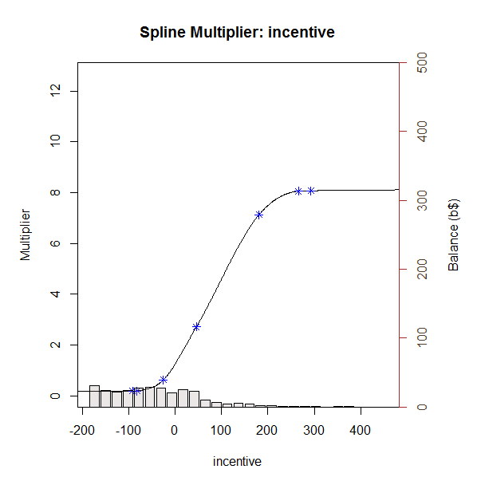
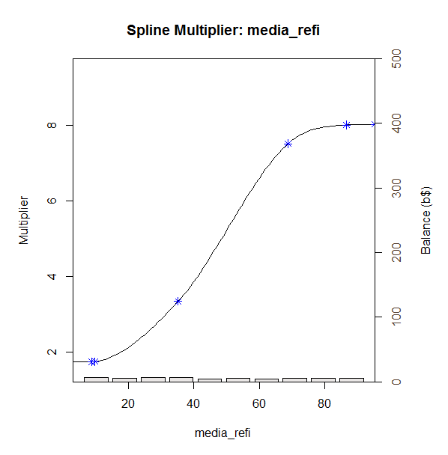
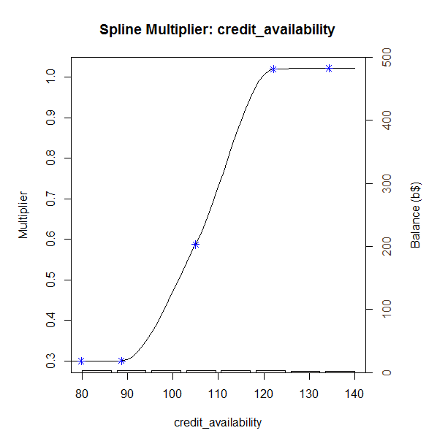
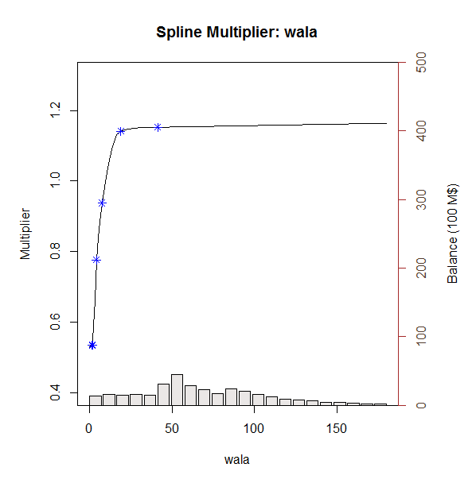
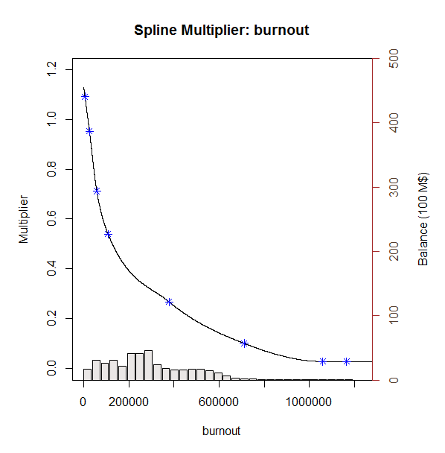
v2 Refinance Model Details 2. Model Multiplier Splines

Slide 16
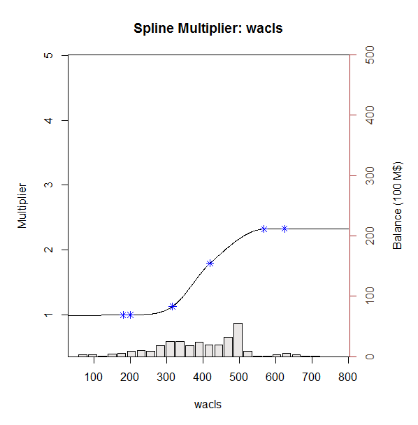
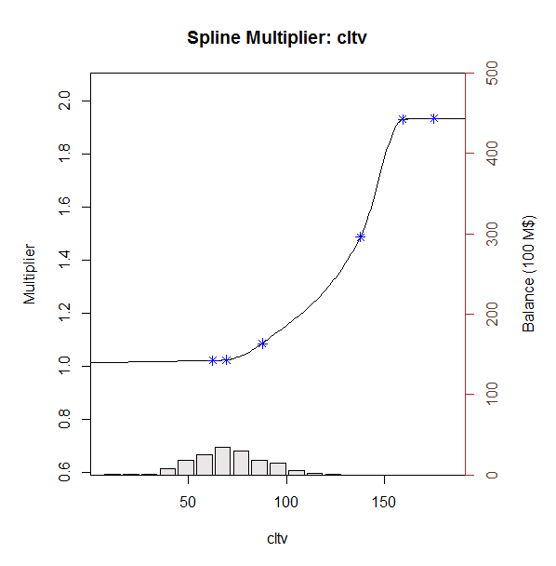
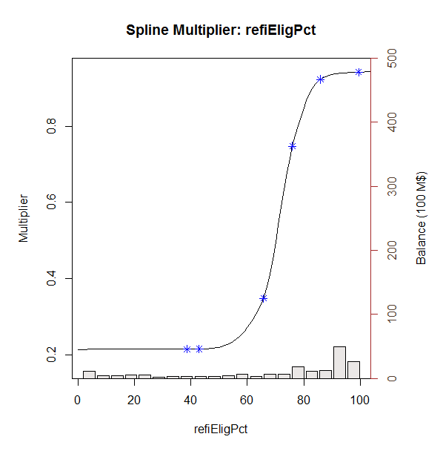
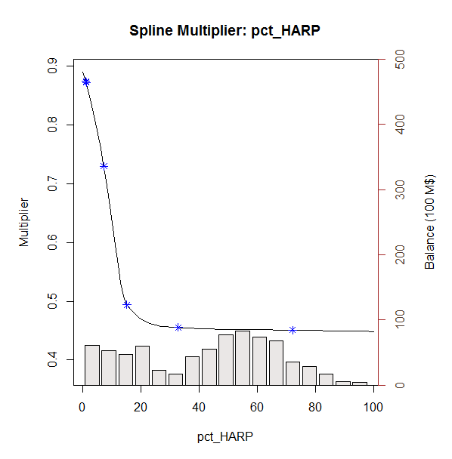
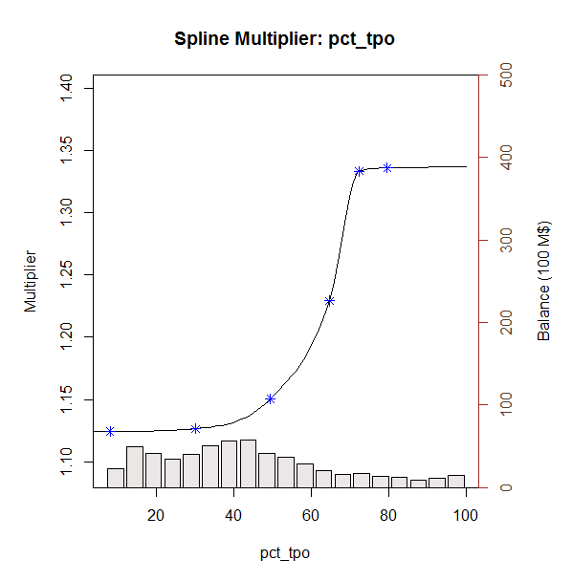
v2 Refinance Model Details 2. Model Multiplier Splines

Slide 17
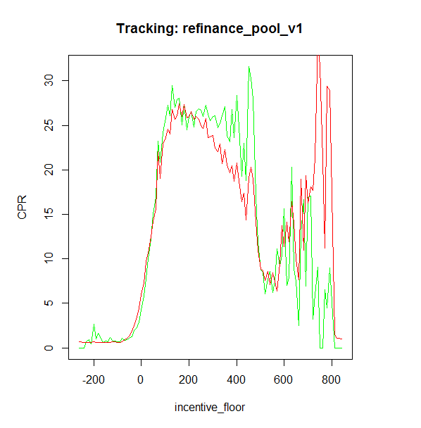
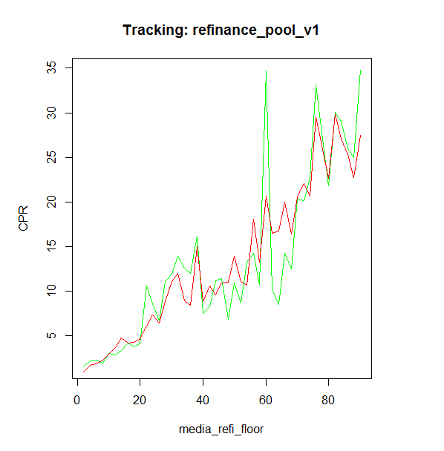
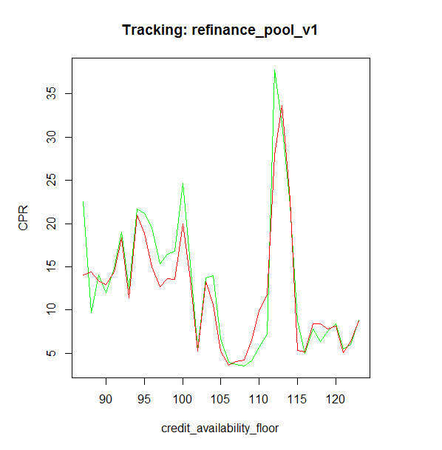
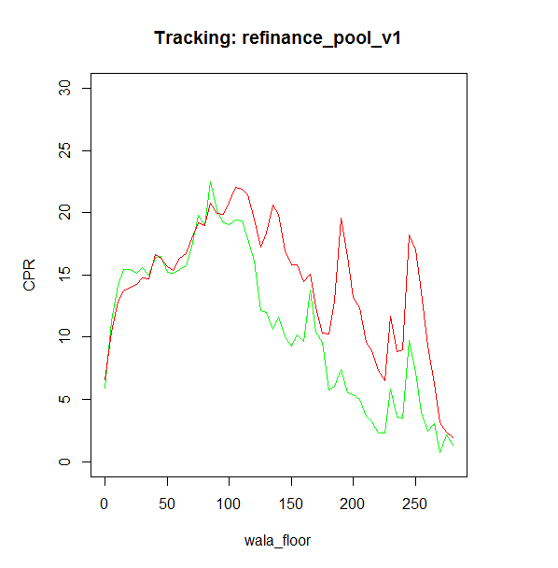
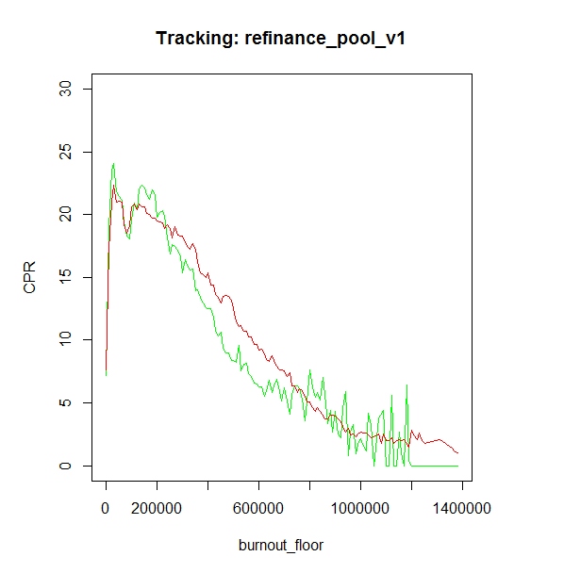
v2 Refinance Model Details 3. Model Multiplier Tracking
Actual
Model

Slide 18
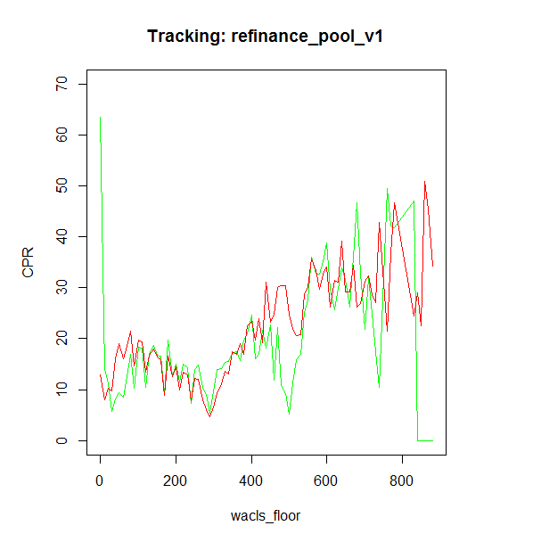
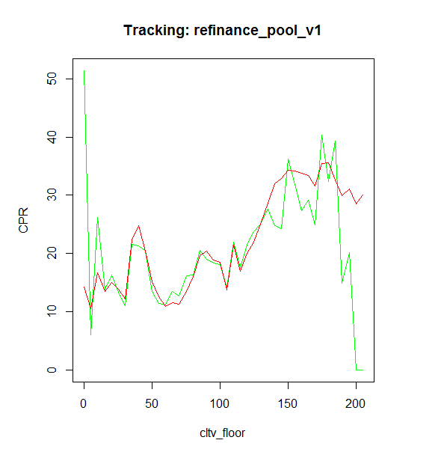
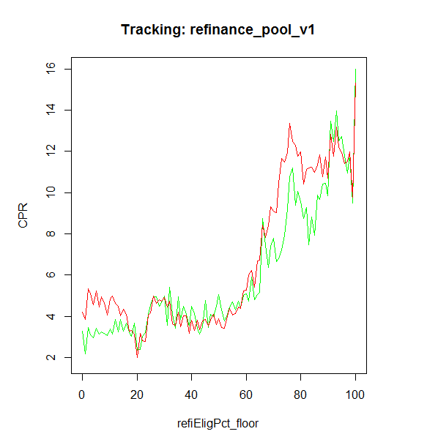
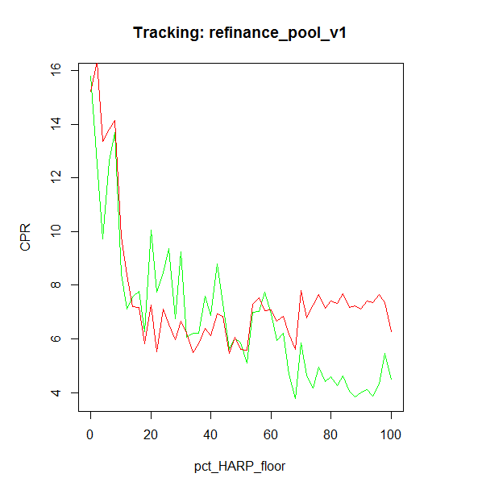
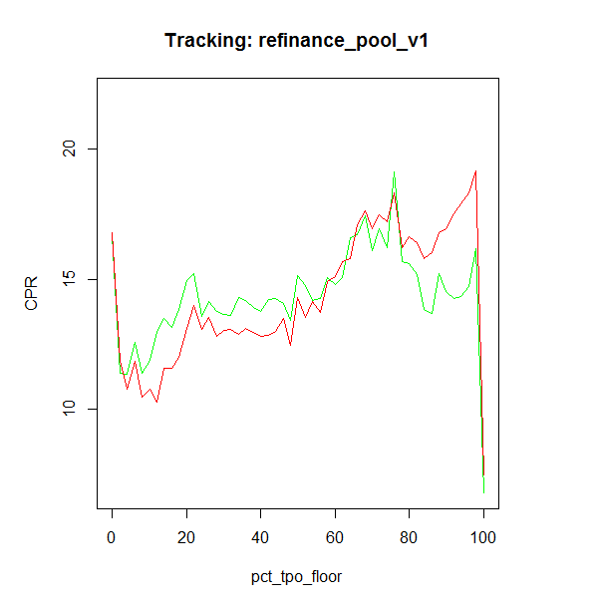
v2 Refinance Model Details 3. Model Multiplier Tracking
Actual
Model

Slide 19
v2 Refinance Model Details 3. Performance Comparasion
Conventional pool tracking shows v2 has smaller tracking error.
Jumbo pools tracking for post 2014 looks faster.
CQ pool tracking is more reliable now, as we fixed the incentive calculation for HARPed loans. V2 model shows better performance for CQs
Similar as CQs. V2 model shows better performance for CRs

Slide 20
Appendix 1. Max Value of Multipliers
 | Min | Max
baselineConstant | 1.86
incentive | 0.19 | 8.08
media | 1.75 | 8.02
creditAvailability | 0.30 | 1.02
burnout | 0.03 | 1.09
wacls | 0.99 | 2.33
cltv | 1.02 | 1.94
refiElig | 0.21 | 0.94
pct_HARP | 0.45 | 0.87
pct_tpo | 1.12 | 1.34
Multiplier | 0.00 | 358.71

Slide 21
Appendix 2. Further Research
Dispersion Between MCAI and HPA2Yr
In our current model, we use HPA two-year moving average as a measure of market credit availability. However, comparing the Mortgage Credit Availability Index and HPA2Yr curves, we can see a dispersion between them after 2013. At the same time, our model tracking error goes up.
We might want to change the credit availability measure in our future version of model. MCAI would be a choice. In that case, since the MCAI is calculated by the origination information of all kinds of loan products(including non-agency products), we need to actively maintain the market share of different products.

Slide 22
Appendix 2. Further Research
Dispersion Between MCAI and HPA2Yr
In our current model, we use HPA two-year moving average as a measure of market credit availability. However, comparing the Mortgage Credit Availability Index and HPA2Yr curves, we can see a dispersion between them after 2013. At the same time, our model tracing error goes up.
We might want to change the credit availability measure in our future version of model. MCAI would be a choice. In that case, since the MCAI is calculated by the origination information of all kinds of loan products(including non-agency products), we need to actively maintain the market share of different products.

